Slide 1
Deep Learning and its implications
Delivered by: Gulraiz Khan

Slide 2
Agenda
Why Deep Learning (DL)
ML VS DL
Which to choose for your problem
Area in which DL can be used
Contributors in DL
DL around the globe
What DL can do
How Deep Learning
Steps involved in DL
Convolution
Classification

Slide 3
Why Deep Learning ?

Slide 4



Slide 5
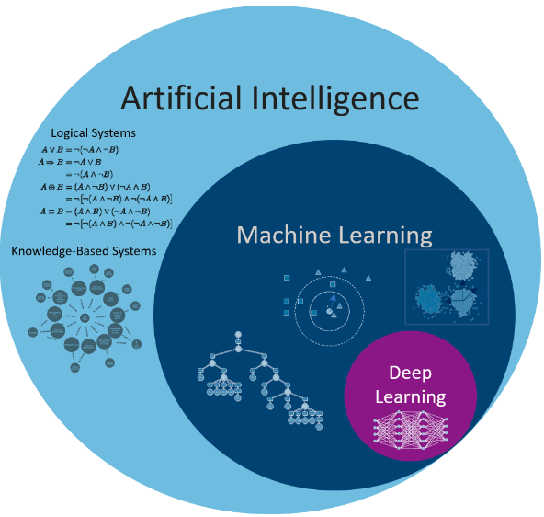
AI vs ML vs DL

Slide 6



Which one to choose
Rule Based
Machine Learning
Deep Learning

Slide 7
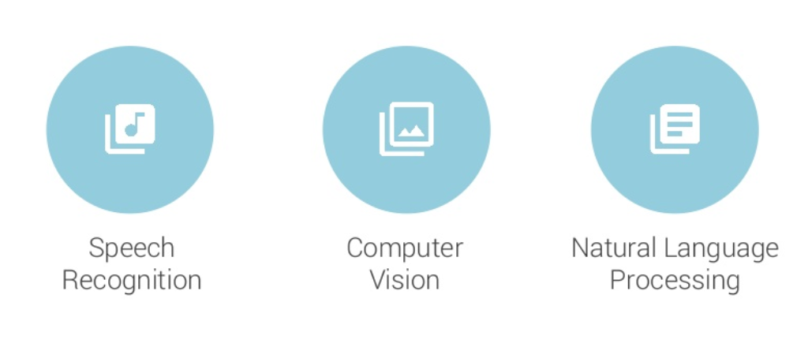
Areas in which DL can be used

Slide 8




Contributors
Understanding Deep Learning will not only enable us to build more intelligent machines, but will also help us understand human intelligence.
(LeCunn: Facebook)
I have Worked all my life in Machine Learning and I’ve never seen one algorithm that knock over banchmarks like Deep Learning.
Andrew Ng (Stanford & Baidu)
Deep Learning is an algorithm which had no theoretical limitations of what it can learn.
Geoffery Hinton (Google & Tronto)
Deep Learning would be complementary tool for human in performing the things that human are not naturally good
Demis Hassabis (DeepMind)

Slide 9




Deep Learning in world
Google language
Search engine ranking
Speech recognition
User preferences
Amazon Rekognition
Amazon Music
Siri
Face Recognition
Friend tagging
Personalized news feed
Mutual friend analysis

Slide 10
What Deep Learning can do?

Slide 11
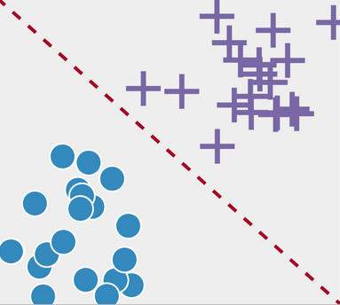
Classification

Slide 12
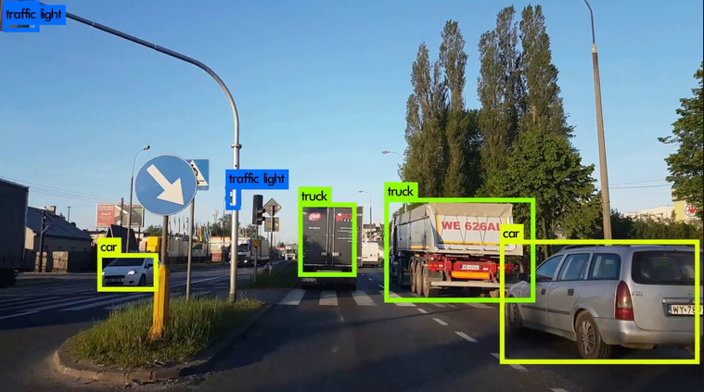
Detection

Slide 13
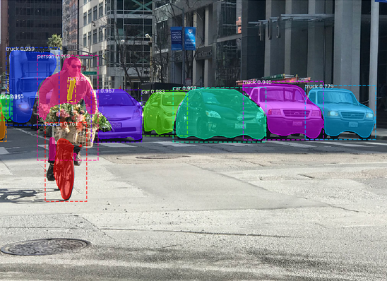
Segmentation

Slide 14
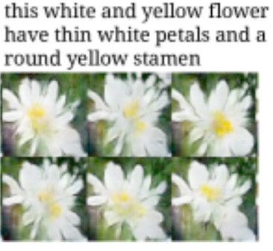
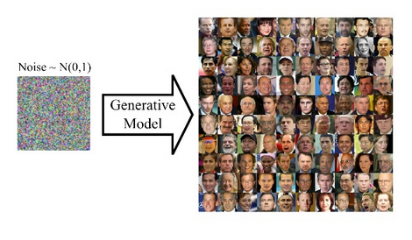
Generation

Slide 15
Demo videos !

Slide 16
How Deep learning?

Slide 17
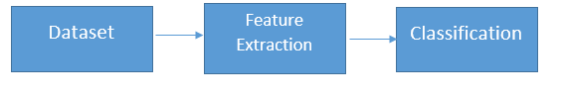

Slide 18


Dataset
Generation
Collection

Slide 19
Title | Link
Text Datasets
Multidomain sentiment analysis dataset |  | http://www.cs.jhu.edu/~mdredze/datasets/sentiment/
Reuters News dataset |  | https://archive.ics.uci.edu/ml/datasets/Reuters-21578+Text+Categorization+Collection
WordNet |  | https://wordnet.princeton.edu/
Audio Datasets
LibriSpeech |  | http://www.openslr.org/12/
Free Spoken Digit Dataset |  | https://github.com/Jakobovski/free-spoken-digit-dataset
Images Datasets
ImageNet |  | http://www.image-net.org/
MS-COCO |  | http://cocodataset.org/#home

Slide 20
Feature extraction
What are features ?

Slide 21

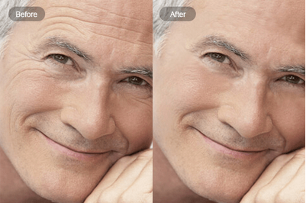
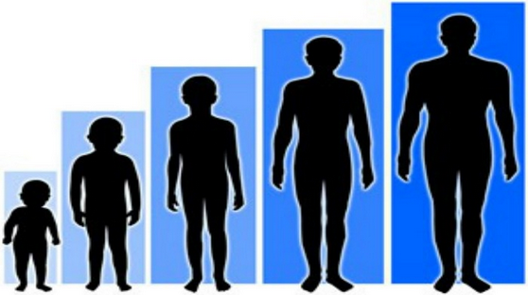
Features for age detection
Wrinkles
Height
Hair Color

Slide 22
Feature extraction processes
Automatic feature extraction using convolution neural network
The kernel slides over the image
Matrix of weights (numbers)
Perform an element-wise multiplication
Finally, summing up the results into a single output pixel

Slide 23
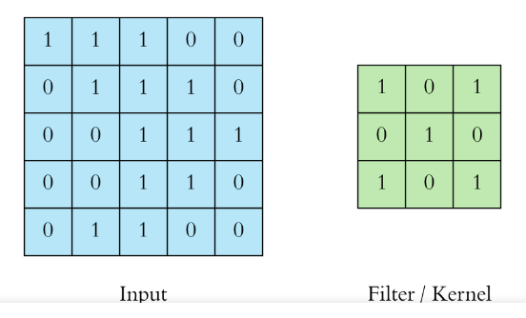
Weight matrix / Kernel / Filter

Slide 24
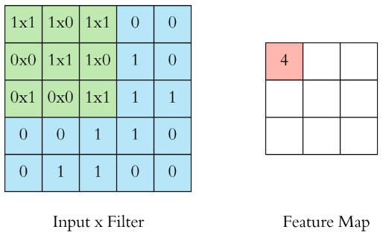
Convolution Processes

Slide 25
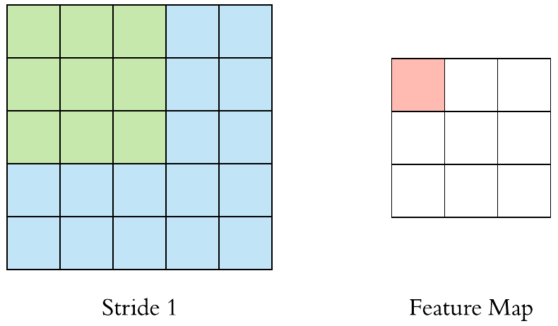
Stride
Stride : How much to jump during window movement, What effect of 1, 2
Notes:
<number>

Slide 26
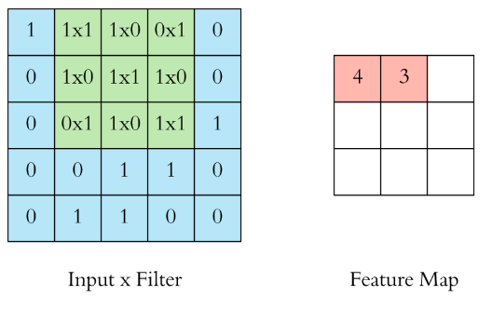

Slide 27
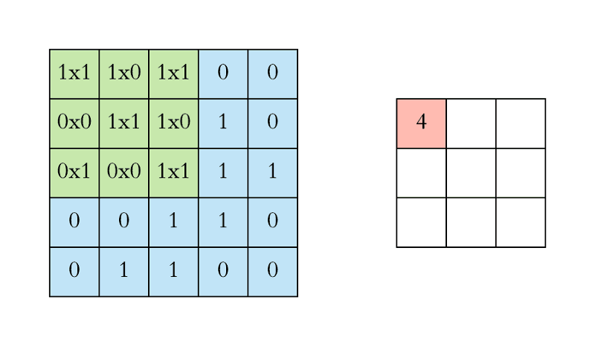

Slide 28
Stride
Stride : How much to jump during window movement, What effect of 1, 2
Notes:
<number>

Slide 29
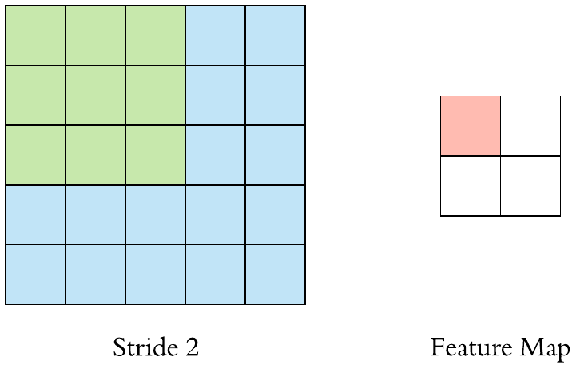

Slide 30
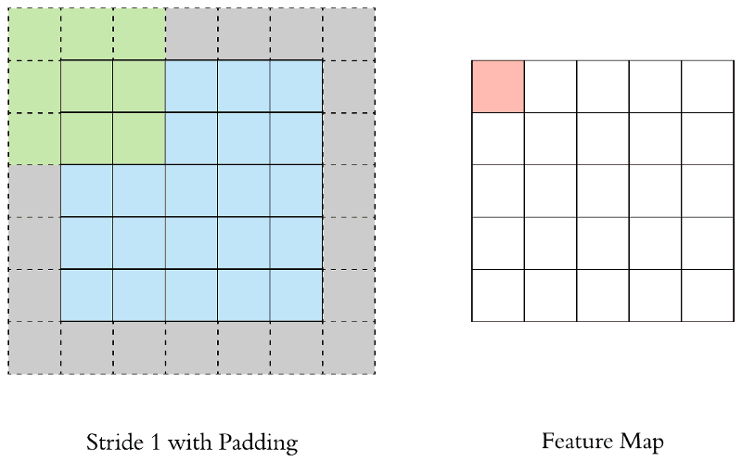
Padding
Padding: Surrounds the input with zeros. Why ?

Slide 31
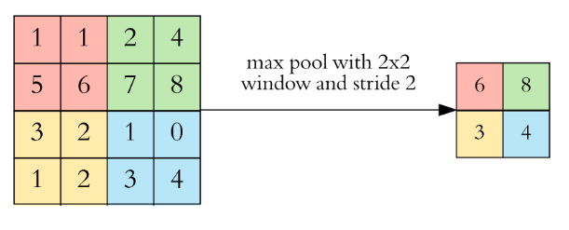
Pooling
Pooling is basically selecting specific value from a pool of values. (Four brother, bike)
Pooling to reduce the dimensionality, Why pooling ?

Slide 32
Mathematically Calculate output feature size
O = [ (I-F+2P) /S ] +1

Slide 33
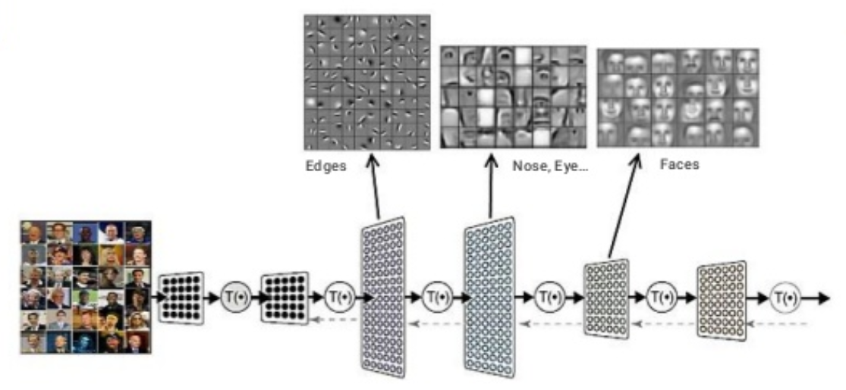

Slide 34
Fully connected layer
Matrix multiplication of the 1x3 input vector (yellow nodes) with the 3x4 weight matrix W1.
The result of this dot product is a 1x4 vector
We then multiply this 1x4 vector with a 4x4 matrix W2, resulting in a 1x4 vector
The green nodes. And finally a using a 4x1 matrix W3 we get the output.

Slide 35
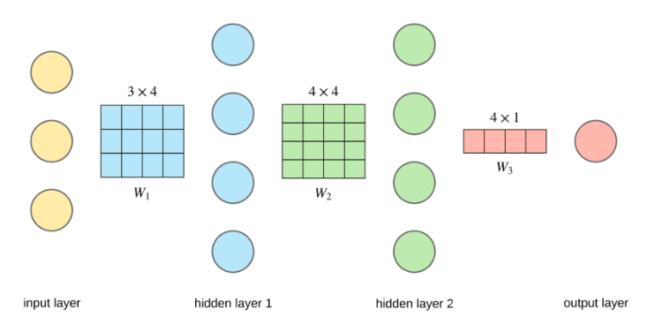

Slide 36
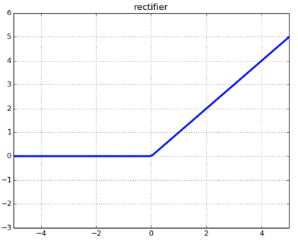
Activation
Transform the features, decide how features should go to next layer.

Slide 37
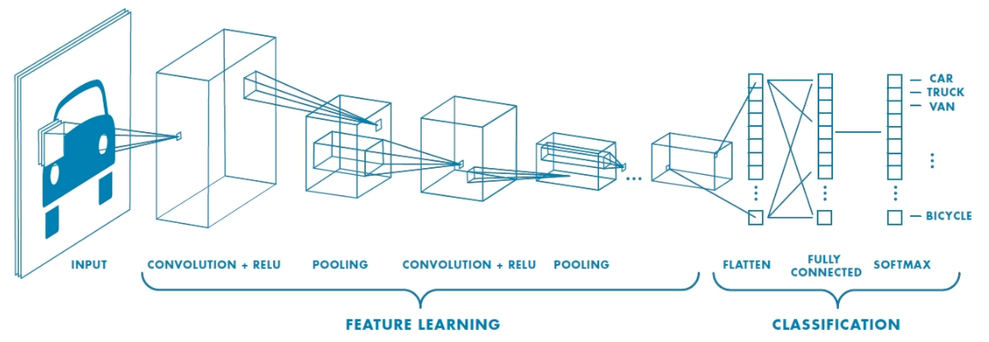
Classification
Finally softmax is used to classify the images

Slide 38
Course Outcome
Learn complete insight of deep neural network
Lear how to prepare data
Frameworks for deep learning
Learn about all activations, poolings
Learn about object detection
Learn about multimedia generation
Learn about segmentation

Slide 39
Questions ?

